Slide 1
WEB DISINGING ASSIGNMENT
DONE BY:
S.AMEERUN SHEHNAS
21COAE008

Slide 2
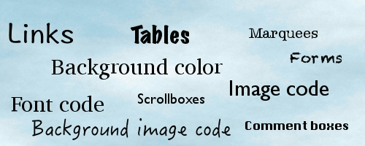

TYPES OF TAGS IN - HTML

Slide 3
BASIC TAGS :
Tag Description
<!DOCTYPE> Defines the document type <html> Defines an HTML document <head> Contains metadata/information for the . document <title> Defines a title for the document <body> Defines the document’s body

Slide 4
BASIC TAGS:
<h1> to <h6> Defines HTML headings <p> Defines a paragraph <br> Inserts a single line break <hr> Defines a thematic change in the . . content <!--...→ Defines a comment

Slide 5
FORMATTNG TAGS :
Abbr> Defines an abbreviation or an acronym <address> Defines contact information for the author/owner . . of a document/article <b>. Defines bold text <bdi> Isolates a part of text that might be formatted in a . . different direction from other text outside it <bdo> Overrides the current text direction

Slide 6
FORMS AND INPUT :
<form> Defines an HTML form for user input <input> Defines an input control <textarea> Defines a multiline input control (text area) <button> Defines a clickable button <select> Defines a drop-down list

Slide 7
IMAGE TAGS:
<img> Defines an image <map> Defines a client-side image map <area> Defines an area inside an image map <canvas> Used to draw graphics, on the fly, via scripting . . . . . . (usually JavaScript) <figcaption> Defines a caption for a <figure> element <figure> Specifies self-contained content

Slide 8
AUDIO / VIDEO TAGS :
<audio> Defines sound content <source> Defines multiple media resources for media elements . . (<video>, <audio> and <picture>) <track> Defines text tracks for media elements (<video> and . . . <audio>) <video> Defines a video or movie

Slide 9
LINKS TAGS :
<a> Defines a hyperlink <link> Defines the relationship between a . . document and an external resource (most . . used to link to style sheets) <nav> Defines navigation links

Slide 10
LISTS TAGS :
<ul>. Defines an unordered list <ol> Defines an ordered list <li> Defines a list item <dl> Defines a description list <dt> Defines a term/name in a description list <dd> Defines a description of a term/name in a description list

Slide 11
TABLES TAGS :
<table> Defines a table <caption> Defines a table caption <th> Defines a header cell in a table <tr> Defines a row in a table <td> Defines a cell in a table <thead> Groups the header content in a table <tbody> Groups the body content in a table

Slide 12
STYLES AND SEMANTICS TAGS :
<style> Defines style information for a document <div> Defines a section in a document <span> Defines a section in a document <header> Defines a header for a document or section <footer> Defines a footer for a document or section <main> Specifies the main content of a document

Slide 13
THANK YOU
Reference: W3 SCHOOLS

